Slide 1

Enhancing User Engagement through Interactive Quizzes Hackathon 2024

Slide 2
Table of Contents
Overview of 'Quiz & Win' Feature.
Goals and Objectives of the Feature.
Feature Breakdown: Daily Quiz Levels and Dynamic Question Bank.
Reward System and lncentives.
User Journey and Workflow for Quiz Participation.
Metrics to Track for Success Evaluation.
Scalability and Future Enhancements for the Feature.
Quiz Examples: Share Market Basics and Angel One Offerings.

Slide 3
Overview of ‘Quiz and Win’ Feature
1
Daily Engagement Boost
2
Knowledge Building
Increase daily app engagement with interactive quizzes.
Educate users about financial markets and AngelOne's resources.
3
Rewarding Experience
4
Community Interaction
Offer incentives like 100 brokerage credit and premium resource access.
Faster engagement through leaderboards and social sharing.

Slide 4
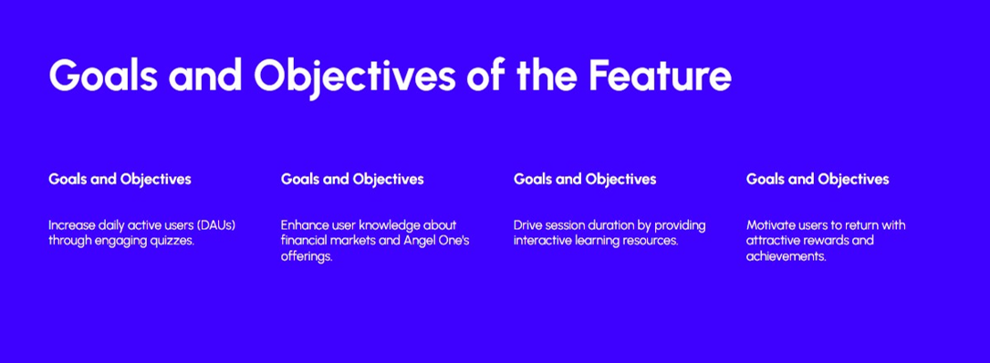

Slide 5



Feature Breakdown: Daily Quiz Levels and Dynamic Question Bank
Daily Quiz Levels
Basic: Suitable for beginners in trading and investments.
Dynamic Question Bank
Over 1,000 questions updated monthly.
Intermediate: Tailored for users with moderate share market knowledge.
Categories include 5 questions on share market/industry basics and 5 questions about Angel One's features or services.
Advanced: Designed for experienced traders.

Slide 6

Reward System and Incentives
R s lOO
F ree
Premium Access
Brokerage Credit
For daily engagement
Access to premium SmartMoney modules for top performers.
Daily/WeeklyI Monthly
Rewards
Gamified
Rewards
Badges, trophies,and leaderboord rankings for motivation
Daily minor rewards and weekly/monthly rewards for continued engagement.

Slide 7
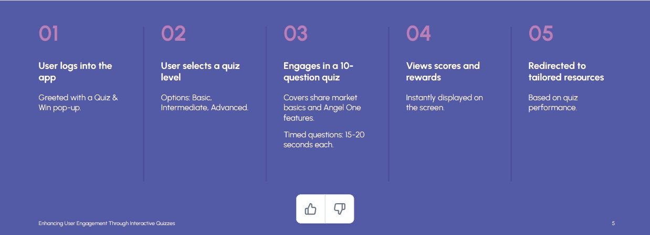
User Journey and Workflow for Quiz Participation

Slide 8
Metrics to Track for Success Evaluation
Daily quiz participation rate
Monitor Engagement
Quizzes completed per user
Track Engagement
Monitor the number of users engaging with the quizzes on a daily basis.
Increase in views
Measure Impact
Track the average number of quizzes completed by each user to gauge ongoing engagement.
Repeat quiz participation
Evaluate Retention
Measure the rise inviews of SmartMoney and in-app tutorials to assess the impact of the quizzes on user learning.
Analyze how many users return to participation quizzes multiple times to evaluate retention rate.

Slide 9
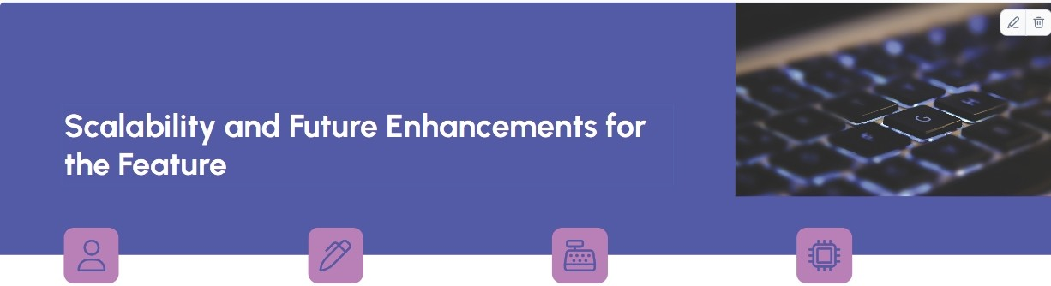

Daily Active Users
Monthl y Updates
Weekly Leaderboards
SmartAPI Ben efit
N umber of daily active users (DAUs) driven through the gamified
quiz feature.
Monthly update frequency for the dynamic question bank.
Weekly leaderboards to showcase top performers.
Access to automated tracing for developers as the main benefit of 'SmartAPI'.

Slide 10
Quiz Examples: Stock Market Basics and Angel One Offerings
Share Market Basics Quiz
Topics Covered: IPO’s, Primary Market Functions, Bull Markets, Stock Exchanges, Blue Chip Stocks, SIP, Mutual Funds, MTF etc.
Angel One Offerings Quiz
Topics Covered: Smart Money, Stock Slice, ARQ Prime, Trading Options, SmartAPI.

Slide 11
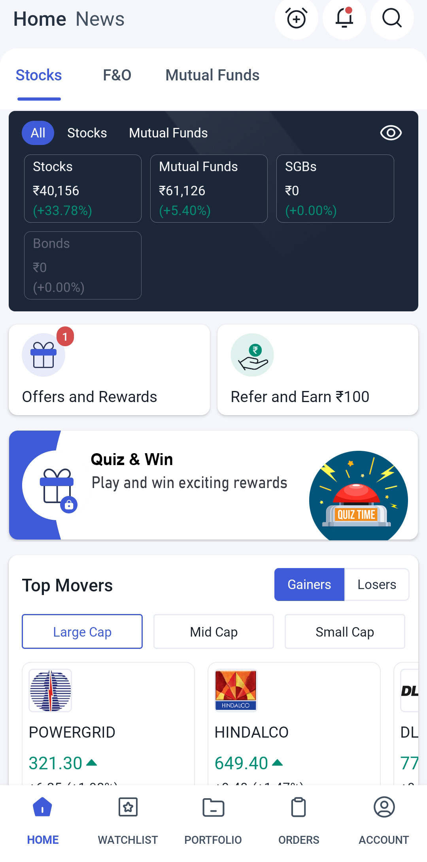
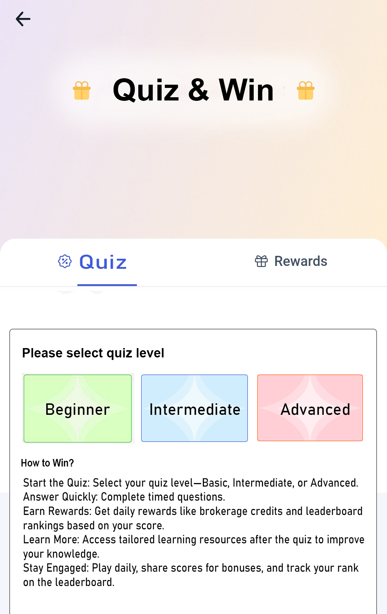
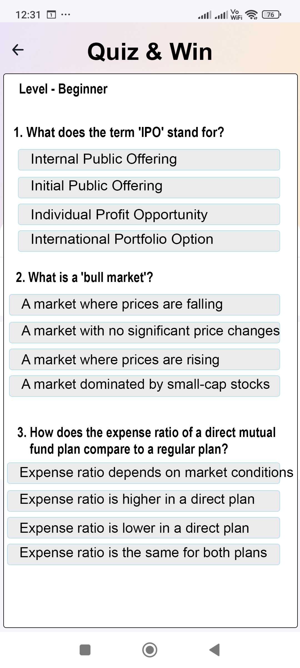
Demo Template for Quiz And Win

Slide 12
Thank You

